Slide 1
Constructor Injection with Dependent Object
www.programmingshifts.com

Slide 2
Constructor Injection with Dependent Object
If there is HAS-A relationship between the classes, we create the instance of dependent object (contained object) first then pass it as an argument of the main class constructor.
Here, our scenario is Employee HAS-A Address. The Address class object will be termed as the dependent object.

Slide 3
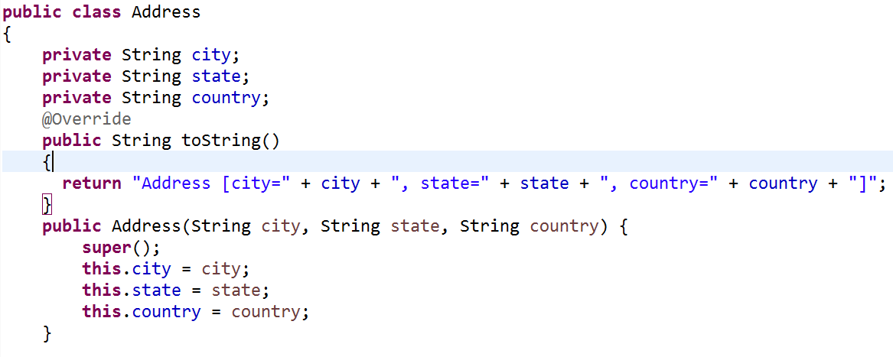
Create Address class:-

Slide 4
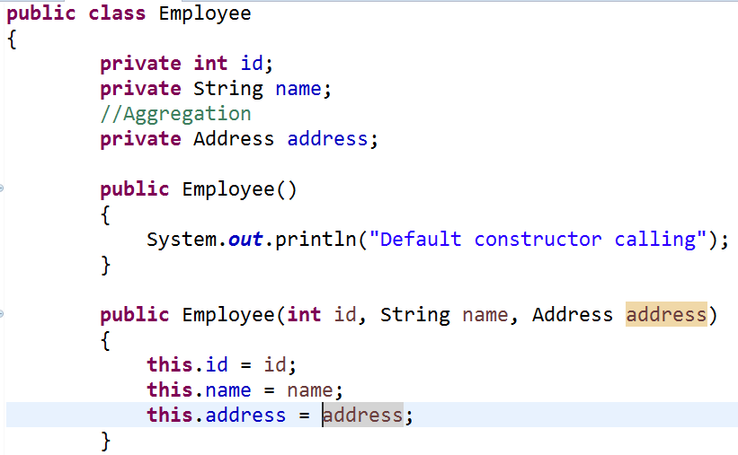
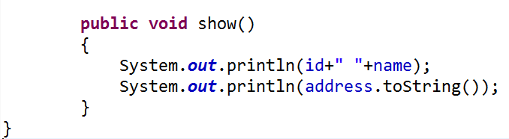
Create a class that contains three properties, one constructor and toString() method to return the values of these object

Slide 5
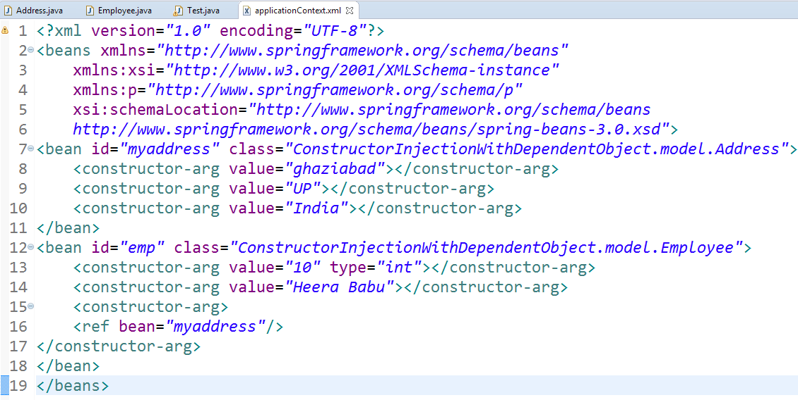
The ref attribute is used to define the reference of another object, such way we are passing the dependent object as an constructor argument.

Slide 6
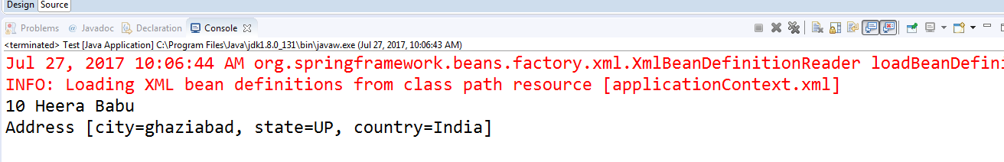
Run Test main class and Get Output:

Slide 7
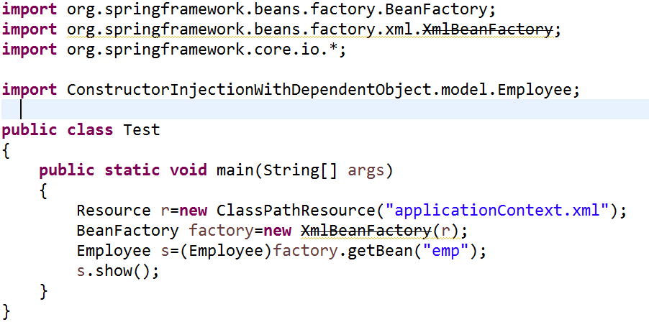
Main class gets the bean from the applicationContext.xml file and calls the show method.

